Slide 1
Common respiratory diseases
Hanan Yusuf

Slide 2
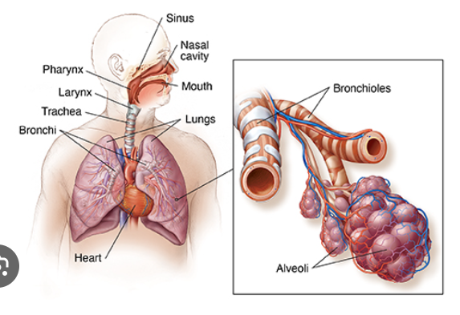

Slide 3
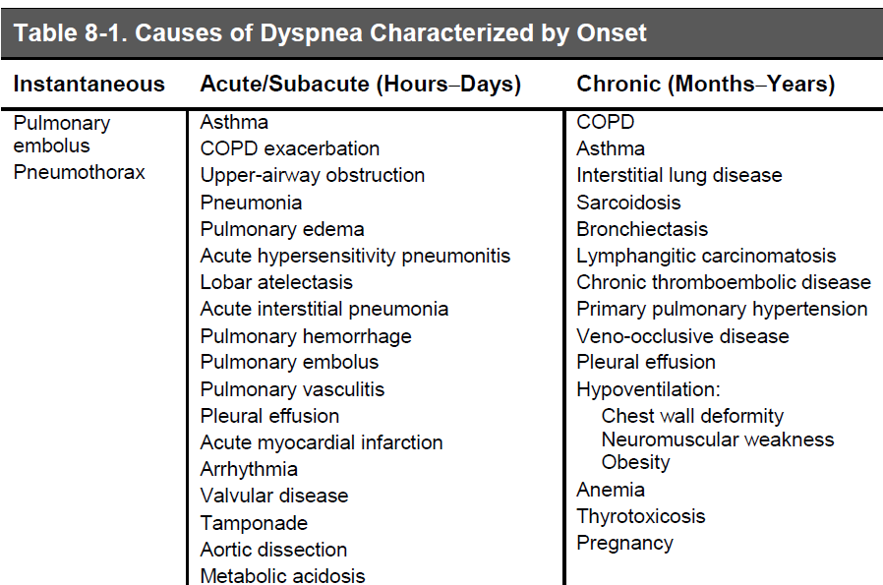
Clinical features

Slide 4
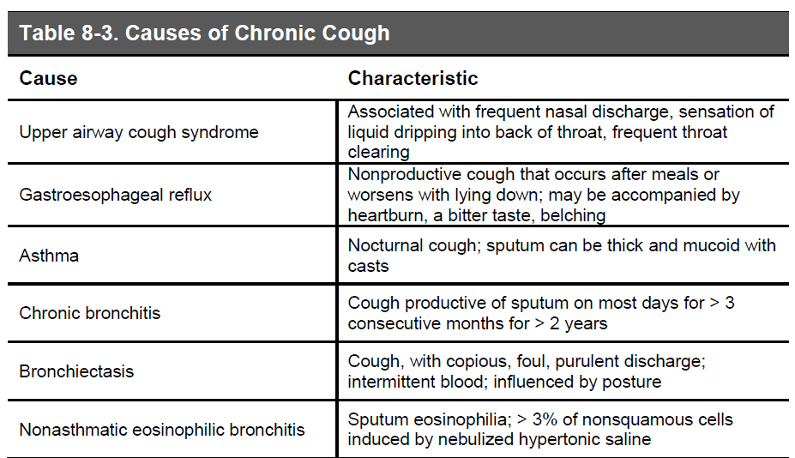

Slide 5
Other potential causes:
• Bronchogenic carcinoma
• Metastatic carcinoma
• Mediastinal tumors
• Sarcoidosis
• Chronic aspiration
• Interstitial lung disease
• Left ventricular failure

Slide 6
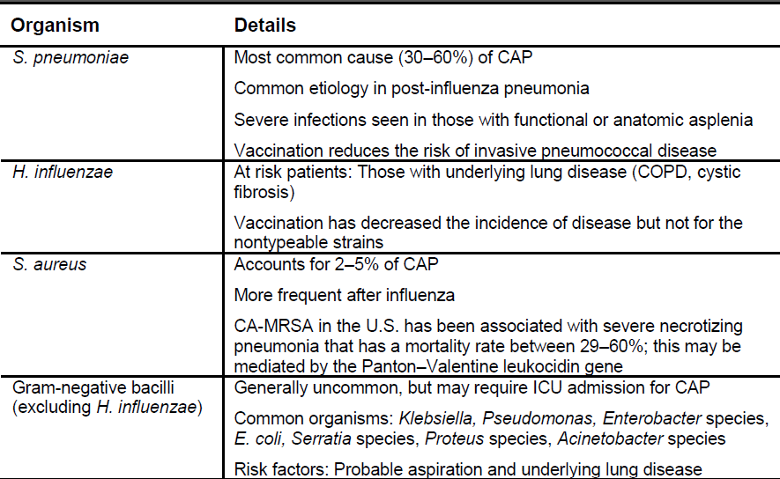
Pneumonia – Typical organisms

Slide 7
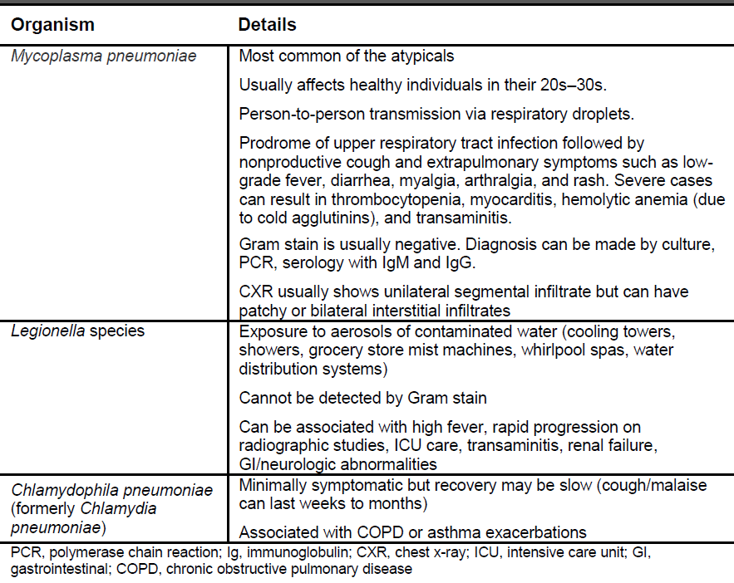
Atypical organisms

Slide 8
CLINICAL FEATURES—Cough with or without sputum, dyspnea, fever or hypothermia, chest pain, chills. Extrapulmonary symptoms: headache, myalgia, and GI symptoms.
PHYSICAL EXAM—Tachypnea, rales, egophony, increased fremitus, and dullness to percussion.
Pneumonia within 48 hours of hospital admission is considered CAP.
IMAGING—CXR showing air space consolidation with air bronchograms strongly suggests bacterial pneumonia. Interstitial infiltrates are not seen with usual bacterial pneumonias.
LABORATORY TESTS
Leukocytosis with a left shift; white blood cell count can be depressed in severe shock or normal in the elderly. Leukopenia portends a poor prognosis. Sputum cultures optional for outpatients with CAP since they do very well with empiric treatment.

Slide 9
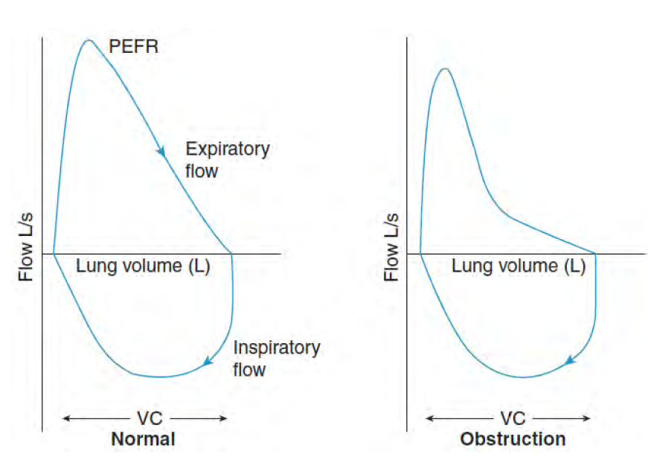
Spirometry

Slide 10
Common Lung Diseases
Obstructive pattern
Asthma
COPD
Bronchiectasis
Restrictive pattern
Diffuse Lung diseases including interstitial lung diseases
Chest wall abnormalities

Slide 11
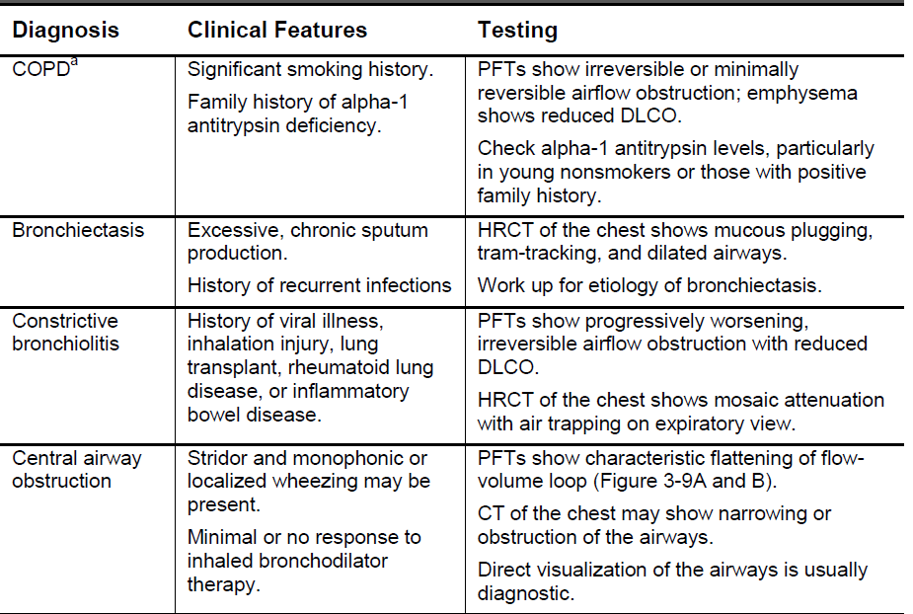
Other causes of Obstructive pattern

Slide 12
Definition
Asthma is a heterogeneous disease, usually characterized by chronic airway inflammation.
It is defined by the history of respiratory symptoms such as wheeze, shortness of breath, chest tightness and cough that vary over time and in intensity, together with variable expiratory airflow limitation.

Slide 13
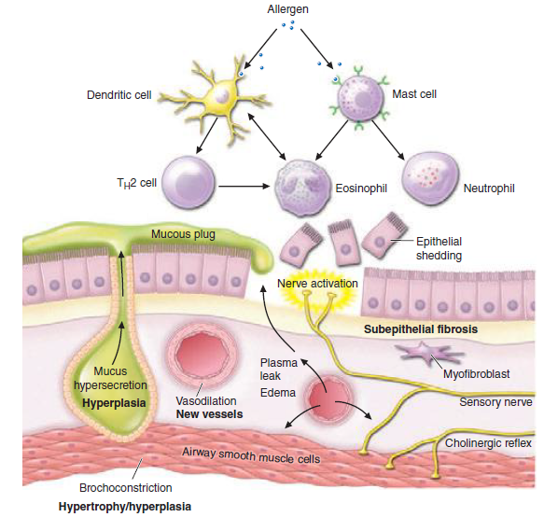
Pathophysiology

Slide 14
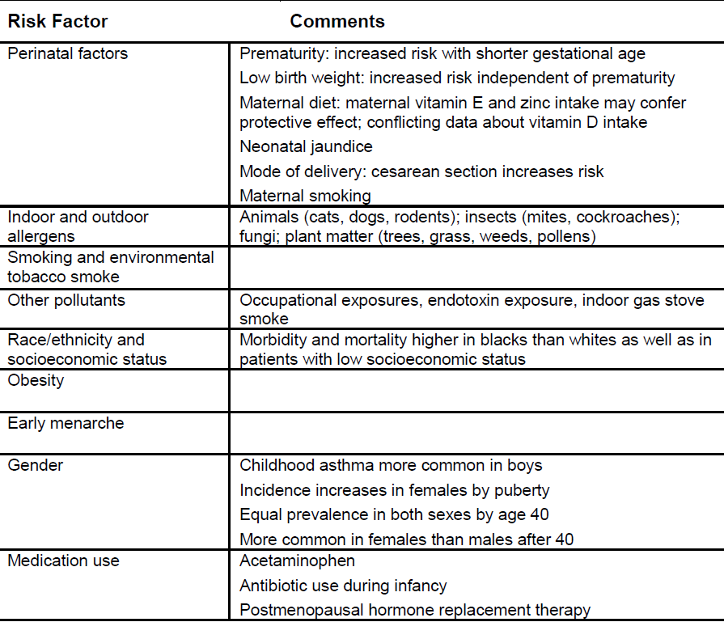
Asthma – Environmental risks

Slide 15
Diagnosis
Symptoms favoring asthma – Varying
+
Evidence of variable airflow limitation

Slide 16
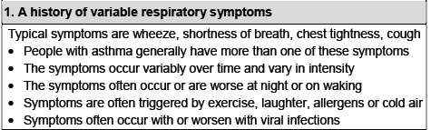

Slide 17
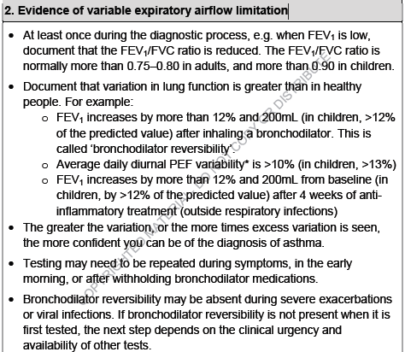

Slide 18
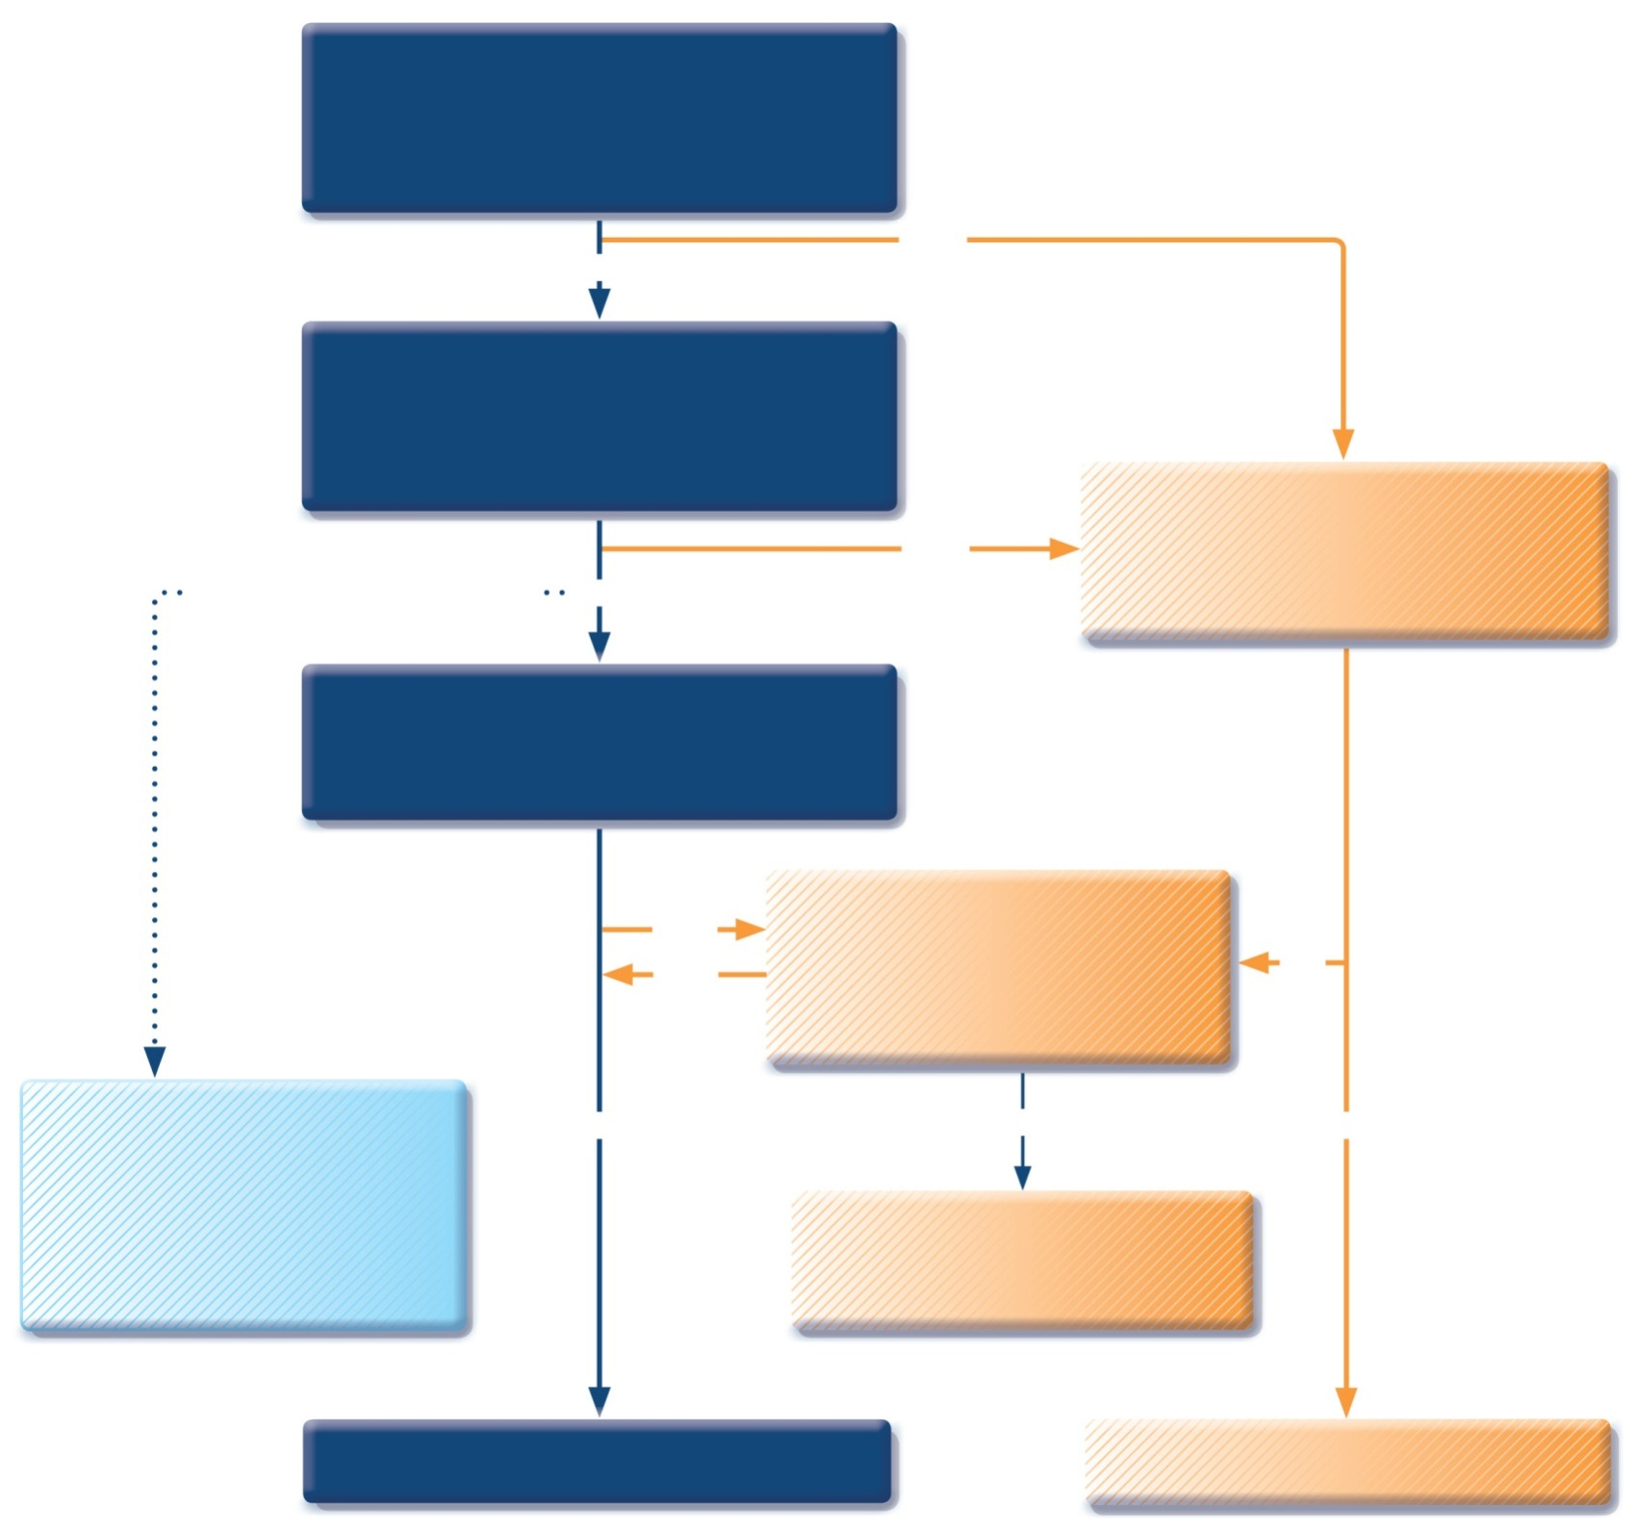
Patient with respiratory symptoms
Are the symptoms typical of asthma?
YES
NO
Detailed history/examination for asthma
History/examination supports asthma diagnosis?
Further history and tests for alternative diagnoses
Alternative diagnosis confirmed?
Clinical urgency, and other diagnoses unlikely
NO
YES
Perform spirometry/PEF with reversibility test
Results support asthma diagnosis?
Repeat on another occasion or arrange other tests
Confirms asthma diagnosis?
NO
YES
NO
Empiric treatment with ICS and prn SABA
Review response
Diagnostic testing within 1-3 months
YES
NO
YES
Consider trial of treatment for most likely diagnosis, or refer for further investigations
Treat for ASTHMA
Treat for alternative diagnosis

Slide 19
Typical spirometric tracings
Flow
Volume
Normal
FEV₁
Asthma (after BD)
Normal
Asthma (before BD)
Asthma (after BD)
Asthma (before BD)
1
2
3
4
5
6
Volume
Time (seconds)
Note: Each FEV₁ represents the highest of three reproducible measurements
GINA 2017

Slide 20
Options?
Bronchodilators
β2-adrenergic agonists
Anticholinergics
Theophylline
Controllers
ICS
OCS
Antileukotrienes
Cromones
Anti IgE

Slide 21
COPD
The Global Initiative for Chronic Obstructive Lung Disease (GOLD) defines COPD as a common, preventable, and treatable disease characterized by persistent airflow limitation that is usually progressive.
It associated with an enhanced chronic inflammatory response in the airways and the lung to noxious particles or gases

Slide 22
COPD
Emphysema is defined as alveolar wall destruction with irreversible enlargement of the air spaces distal to the terminal bronchioles and without evidence of fibrosis.
Chronic bronchitis is defined as a productive cough that is present for a period of 3 months in each of 2 consecutive years in the absence of another identifiable cause of excessive sputum production.
PATHOPHYSIOLOGY
COPD is characterized by chronic inflammation of the airways, lung tissue, and pulmonary blood vessels. Protease-antiprotease imbalance and oxidative stress are also involved in the pathogenesis of COPD.

Slide 23
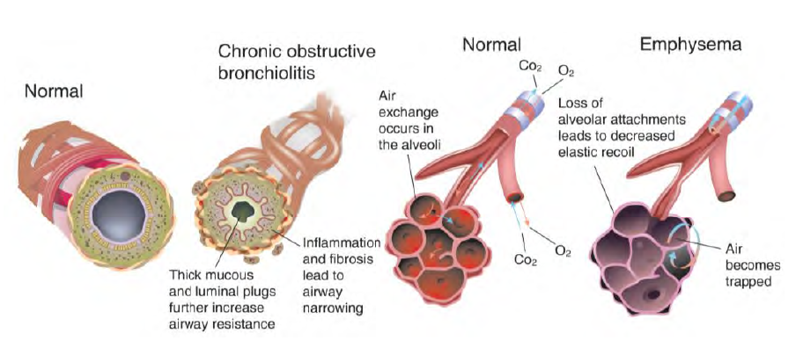

Slide 24
Associated comorbidities such as cardiovascular disease and diabetes
The Global Mortality and Burden of Disease project estimates COPD
mortality will rank fourth worldwide and third in middle-income countries by 2030.
Cigarette smoking is the single most important risk factor for the development of COPD.
However, a significant burden of disease occurs in nonsmokers. Alpha-1antitrypsin deficiency and occupational exposures are implicated as the other major causes of COPD.
Other significant causes include outdoor air pollution, secondhand smoke, and biomass smoke

Slide 25
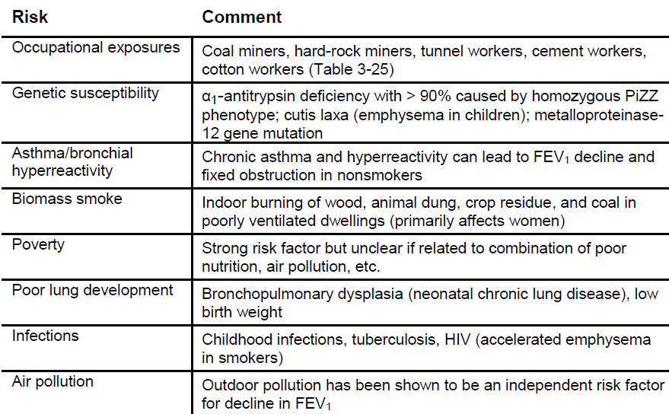

Slide 26
Symptom
A diagnosis of COPD should be suspected in any patient with dyspnea, chronic cough or sputum production, and a history of exposure to known risk factors.
Symptom onset is usually in the fifth decade of life or later and often brought to light by respiratory infections.
ADDITIONAL CLINICAL FEATURES—Other symptoms associated with COPD are important prognostically or may represent other disease processes (e.g., tuberculosis, lung cancer, congestive heart failure).
Wheezing and chest tightness, Fatigue, Weight loss/muscle wasting; inflammatory mediators from the lung may play a role, Anorexia, Ankle swelling; may represent cor pulmonale, depression

Slide 27
Physical Exam
Abnormal physical exam findings are mostly present in severe disease.
Chest wall hyperinflation; limited diaphragmatic motion on auscultation
Decreased intensity of breath and/or heart sounds
Wheezing and prolonged expiratory time
Pursed-lip breathing and use of accessory respiratory muscles
Positional relief of dyspnea: leaning forward, arms outstretched with palms or elbows used to bear weight
Cyanosis
Digital clubbing is not typical in COPD and may reflect other disease processes (e.g., lung cancer)
Lower extremity edema may occur with or without cor pulmonale
Asterixis rare but can be seen with severe hypercapnia

Slide 28
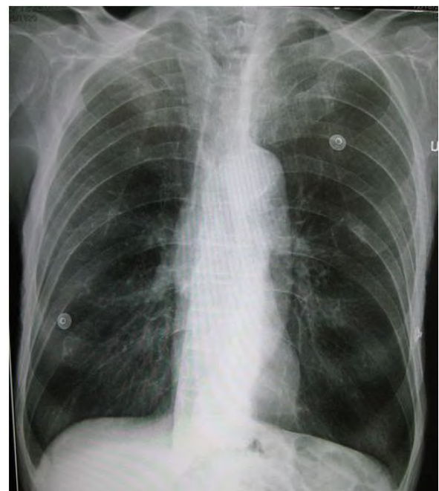
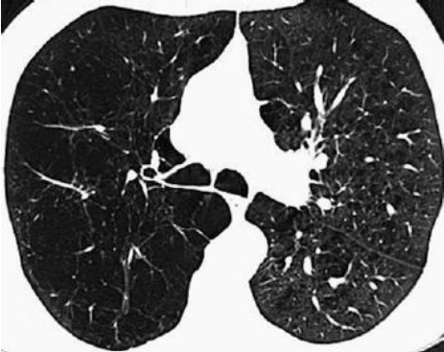
Imaging

Slide 29
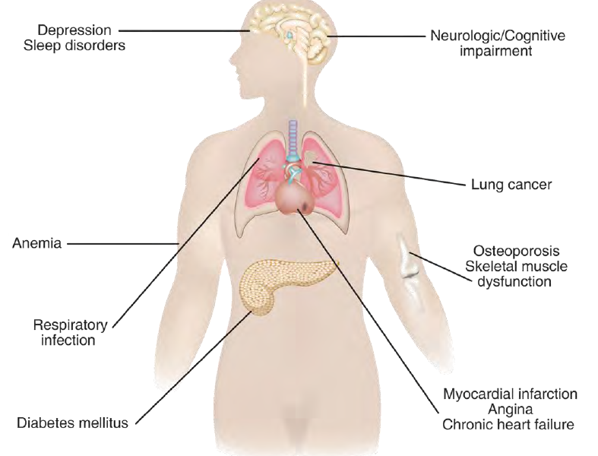
COPD- comorbidities

Slide 30
COPD TREATMENT
Smoking Cessation
VACCINES—Influenza and pneumococcal vaccines
LABA, long-acting ß agonist; LAMA, long-acting, muscarinic antagonist; SABA, short-acting ß agonist; SAMA, short-acting muscarinic antagonist.
ICS, inhaled corticosteroids and combinations of ICS and bronchodilators
Non-pharmacologic – Oxygen, Pulmonary Rehabilitation, Lung volume reduction surgeries

Slide 31
Lung Cancer
WHO defines lung cancer as tumors arising from the respiratory epithelium (bronchi, bronchioles, and alveoli).
Lung cancer causes as many deaths as the next three leading causes of cancer deaths combined.
For many years, lung cancer was a relatively neglected disease, shrouded in pessimism and with little research funding

Slide 32
Clinical manifestations
Around 3/4th of patients are symptomatic at presentation.
Intrathoracic effects
The most common are cough(50-75%), hemoptysis(25-50%), dyspnea (25-50%) and chest pain (20%).
Predominance of local symptoms depend on the site &/or extent of invasion
Central/endobronchial masses- Cough, hemoptysis, wheeze, stridor, dyspnea, or post obstructive pneumonitis.
Peripheral masses - Pain from pleural or chest wall involvement, dyspnea on a restrictive basis, and symptoms of a lung abscess resulting from tumor cavitation
R

Slide 33
Features of local invasion
Hoarseness of voice (RLN), pleural effusion, Superior vena cava (SVC) syndrome and Pancoast syndrome.
SVC syndrome: obstruction of SVC causing prominent venous pattern on the chest, neck and facial edema. Common in SCLC.
Extrathoracic metastases
Most common sites are liver, adrenals, bones and brain

Slide 34
Pancoast tumor = Superior sulcus tumor. (Tumor arising above the pulmonary sulcus)
Mostly caused by NSCLC
Pancoast syndrome- Shoulder pain (most common), Horner’s syndrome and hand muscle atrophy.
Horner’s syndrome- enophthalmos, ptosis, miosis, and anhydrosis.

Slide 35
Evaluation of Lung Cancer Patients
Non Invasive assessment
CXR, CT scan, PET
Semi- Invasive
Bronchoscopy, Endobronchial Ultrasound, Trans Thoracic sampling
Invasive
Mediastinoscopy, Open surgery, Video assisted Thoracoscopy

Slide 36
Establishing tissue diagnosis
Use the least invasive approach unless necessary
Diagnostic sampling should start from a lesion yielding the highest stage
For central masses- Sputum cytology, endobronchial biopsy
For peripheral lesions – Transthoracic lung biopsy
Mediastinal lymphnodes- Transbronchial biopsy or Transbronchial needle aspirations
For pleural effusions- Pleural fluid cytology, image guided closed pleural biopsy or Video Assisted Throcoscopic biopsy

Slide 37
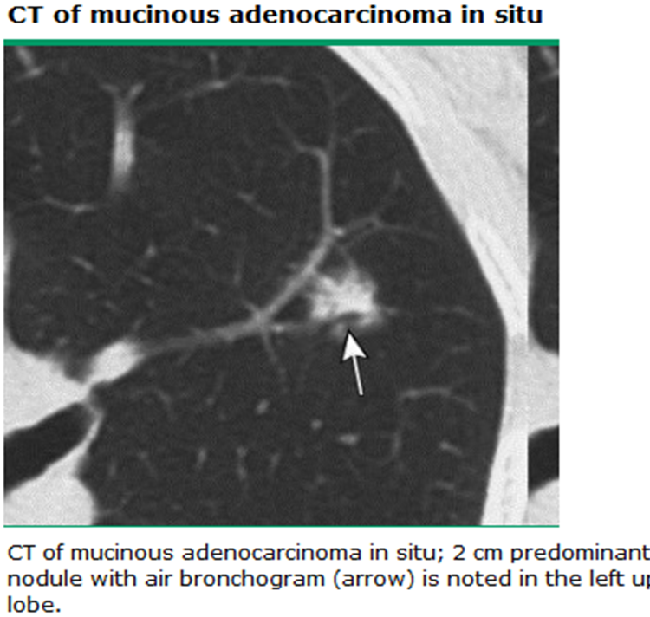
Non-invasive assessment
CT assessment
TUMOR – Lung window
Size
Presence/absence of separate tumor nodule
Presence/absence of atelectasis/obstructive pneumonia
Possible invasion of adjacent structures
Proximal extent of tumor
Node- Mediastinal window
Stations 1- 14

Slide 38
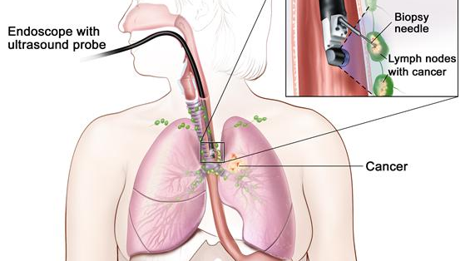
Minimally invasive- Bronchoscopic biopsy
For tissue diagnosis of central lesions/sampling of central lymph nodes for diagnosis or staging

Slide 39
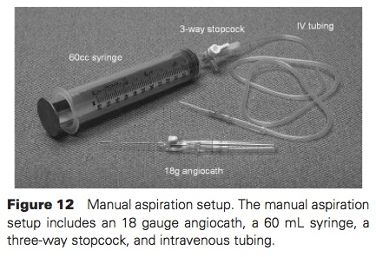
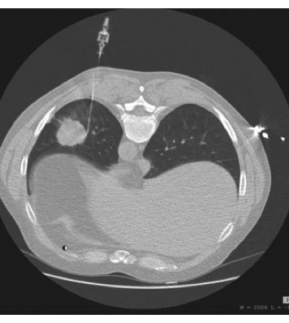
Transthoracic lung biopsy

Slide 40
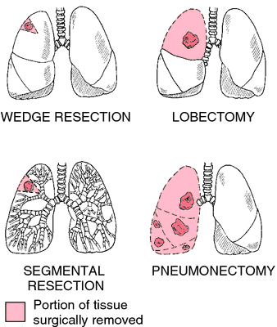
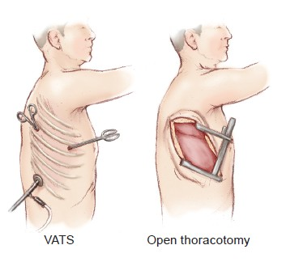
Invasive - Surgical biopsy or resection

Slide 41
Management Depends on
Cell type
Tumor stage
Molecular characteristics of the tumor
Patients overall medical condition
Intention of management
Early- curative- combinations of modalities
Late- Palliative – Mostly chemo

Slide 42
